Slide 1

Regular Expressions for Real-World Text Processing
Co1-AT2 Technical Presentation
A.Sai Rohit (19272144)
DSA0307
Guided By:
Dr.K.Anbazhagan

Slide 2
Introduction
What are Regular Expressions (Regex)?
Regular Expressions (Regex) are patterns used to search and manipulate text.
They help identify specific text formats within large datasets.
Regex is supported in programming languages like Python, Java, JavaScript, and C#.
Applications
Data validation
Text searching
Information extraction
Data cleaning

Slide 3
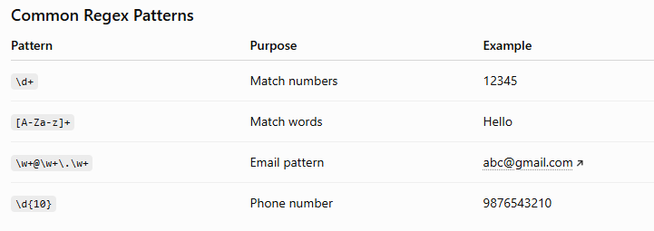
Pattern Matching Using Regex

Slide 4
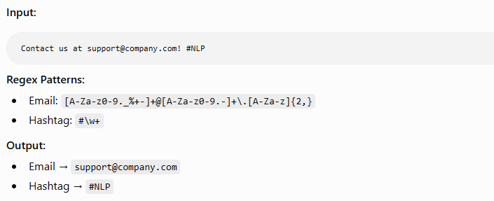
Information Extraction
Extracting Useful Information
Regex can extract:
Email addresses
Phone numbers
Dates
URLs
IDs
PIN codes

Slide 5
Real-World Applications
📧 Validate email addresses
📞 Check phone number formats
🔑 Verify strong passwords
🌐 Extract URLs from web pages
📄 Find dates, numbers, or keywords in documents
🤖 Used in NLP, web scraping, and data cleaning

Slide 6
Conclusion
Regular Expressions simplify text processing.
They efficiently perform pattern matching and information extraction.
Regex is widely used in software development, NLP, cybersecurity, healthcare, and data analytics.
Learning Regex improves automation and text analysis skills.

Slide 7
THANK YOU

